Slide 1

GROCERY STORE MANAGEMENT SYSTEM
Presented By:
B.Keshav
Batch no: 493

Slide 2
About me:
Background: B.TECH – CSE(DS)
Course: Data Analytics (Innomatics Research Labs)
Why Data Analytics : I am interested in Data Analytics because it helps transform data into meaningful insights that support better business decisions.
Linkedin :https://www.linkedin.com/in/keshav-bangari-058062312
Github :https://github.com/keshavbangari

Slide 3
Agenda
Business Problem
Problem Statement
ER Diagram
Queries
Key Insights
Conclusion
Recommendations

Slide 4
Business Problem:
Manual recording of sales and inventory causes errors.
Difficulty tracking stock availability and product quantity.
Frequent stock shortages or overstock situations.
Time-consuming billing and checkout process.
Lack of proper customer and supplier management.

Slide 5
Problem Statement:
The company needs a database system that can store and analyze retail data efficiently. The objective is to use SQL queries to identify top customers, best-selling products, sales trends, and supplier performance, enabling data-driven decision-making

Slide 6



Tables
Supplier Table
Categories Table
Orders Table

Slide 7


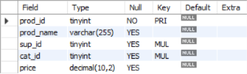
Tables
Employes Table
Customers Table
Products Table

Slide 8
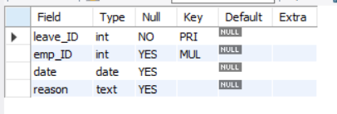
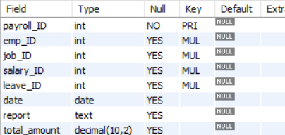
Tables
Leaves Table
Payroll Table

Slide 9
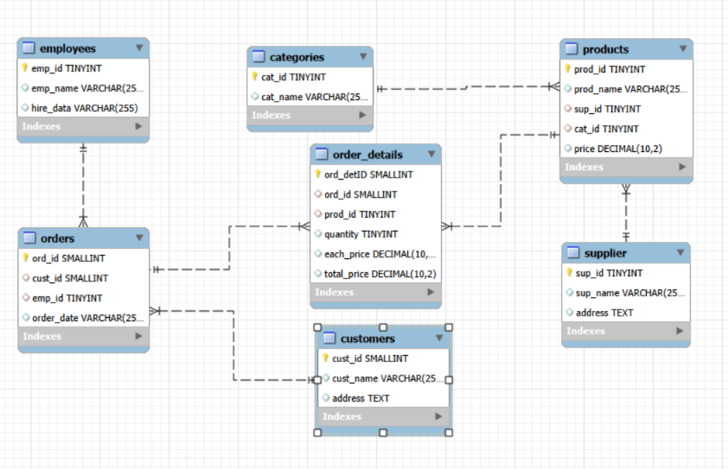
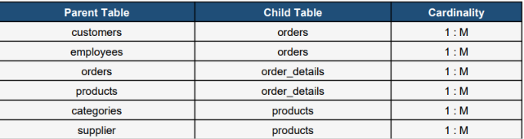
ER DIAGRAM

Slide 10
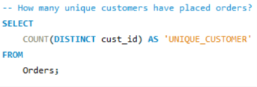

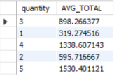

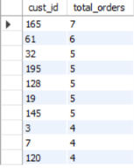
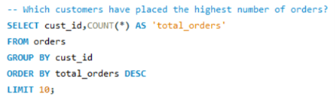
Queries
1.How many unique customers have placed orders ?
2.What is the relationship between quantity ordered and total price ?
3.Which customers have placed the highest number of orders?

Slide 11
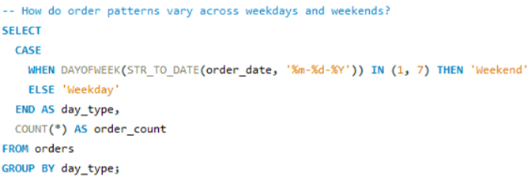

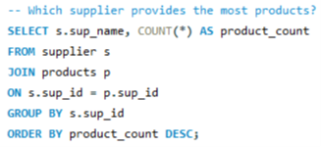
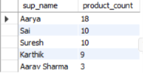
Queries
4.How do order patterns vary across weekdays and weekends ?
5.Which supplier provides the most products ?

Slide 12
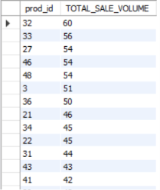

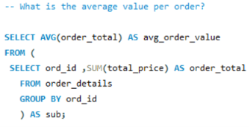

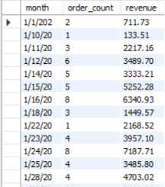
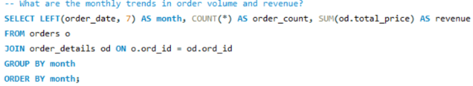
Queries
6.Which products have the highest total sales volume (by quantity)?
7.What is the average value per order ?
8.What are the monthly trends in order volume and revenue ?

Slide 13
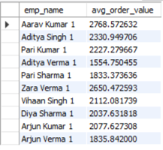
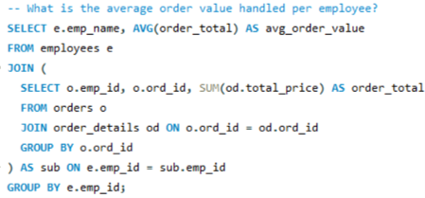
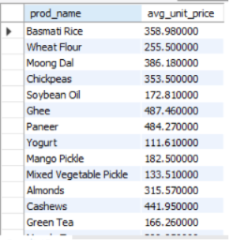
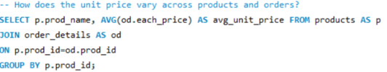
Queries
9.What is the average order value handled per employee ?
10.How does the unit price vary across products and orders ?

Slide 14
Key Insights:
Increased sales tracking and monitoring
Reduced manual work and errors
Improved stock management
Faster billing process
Avoided out-of-stock products
Managed product details easily

Slide 15
CONCLUSION:
The Grocery Store Management System helps manage daily store operations in an easy and efficient way. It reduces manual work, improves inventory tracking, speeds up billing, and helps maintain accurate sales records.

Slide 16
Recommendations:
Implement automatic stock alerts to avoid out-of-stock products.
Maintain regular updates of product and inventory data.
Use sales reports to identify top-selling products.
Improve billing speed to enhance customer experience.
Track expiry dates to reduce product wastage.

Slide 17
Question
Q/A
Answers

Slide 18

THANK YOU

